Slide 1
Board Governance
Daniel White
Alabama PTA Field Service Representative

Slide 2
Why Are We Here?
Remember the Mission of PTA:
To Make Every Child's Potential a Reality by Engaging Families and Communities to Advocate for All Children.
Notes:
The mission of PTA drives everything that we do. Ask yourself, how does this support the mission of PTA?

Slide 3
Basic Governance Questions
What is the Board of Directors?
Governance
Leadership
Operations
Who is the Board of Directors?
Officers
Principal
Standing Committee Chairs

Slide 4
Governance Best Practices
Consult your bylaws
Know your duties and dates
Maintain all records
Develop a plan to do the work

Slide 5
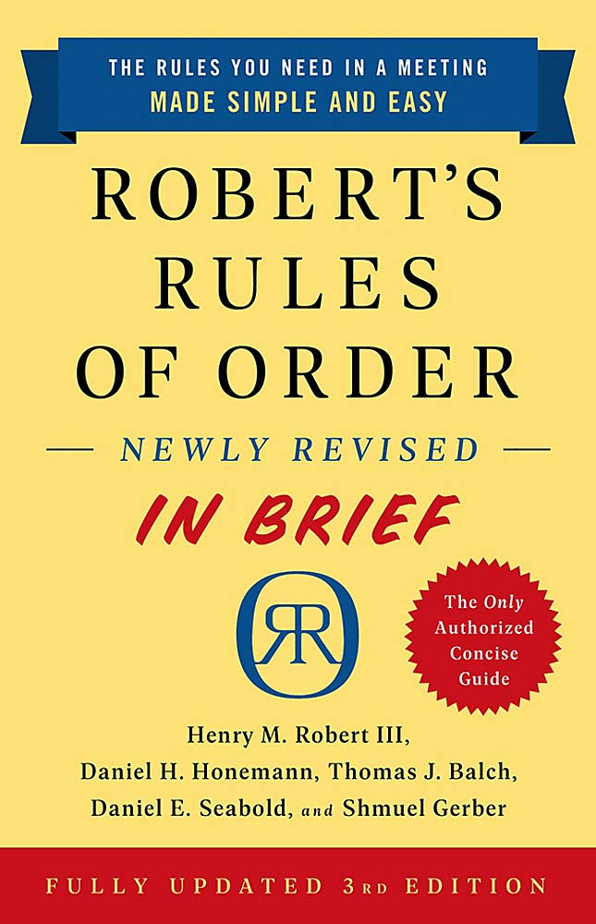
Bylaws
READ YOUR BYLAWS
If something goes wrong, your bylaws can protect you
Pay careful attention to the section related to your position
What do I need to know?
Look at the “Top Ten Things to Read in Your Bylaws” handout

Slide 6
Good Standing
A local PTA in good standing:
(i) Adheres to the purposes and basic policies of PTA (ii) Remits dues to Alabama PTA by dates designated in these bylaws (iii) Has a current officer list on file in the Alabama PTA office, and (iv) Must have bylaws which have been updated within the last three (3) years on file in the
Alabama PTA Office. (v) Must maintain its 501©(3) tax exempt status or be actively working in conjunction with
Alabama PTA to have its tax exempt status reinstated (See Standing Rules), (vi) Must maintain membership levels as follows: A minimum of 15 members for schools
with enrollment of 200 or less students, 25 members for schools with enrollment of 201 to 500 students, and 50 members for schools with enrollment of greater than 500 students, and
(vii) If located with an organized council, follows adopted guidelines of that council in paying dues and/or participating in other programs.

Slide 7
Communication
You need a system
Memberhub – This tool is already available to you!
GroupMe (for BOD or Executive Committee)
Email
People don’t know what they don’t know

Slide 8
What Are My Strengths?
Think about your top three strengths that related to PTA/board service
Think outside the box
Its doesn’t have to relate to your position or title
How can we use our different strengths to work as a team?

Slide 9
What Are My Weaknesses?
What are three weaknesses or things you don’t like to do?
Why is it important to know this about each other?
We need to play to our collective strengths, and support each other’s weaknesses

Slide 10
How To Deal With Conflict?
Talk
Often, problems are a result of miscommunication
If needed, bring in a third party
Compromise
Everyone won’t be happy all the time
What is best for the Association?
Ask For Help!
Your Council is here to help
Don’t let the problem grow past the point of recovery

Slide 11
Questions?
Important Websites
https://www.alabamapta.org/bylaws
https://www.alabamapta.org/pta-awards
https://www.alabamapta.org/good-standing
https://www.alabamapta.org/keydates
How to Reach Me:
danielhwhite@gmail.com
404-314-5900

